Slide 1

Unlocking Health Insights:
iVision's Data Analysis Collaboration with the FDA
Collaborating with the FDA, iVision endeavors to leverage advanced data analysis methodologies to strengthen regulatory oversight and ensure the safety and efficacy of consumer products, advancing public health initiatives

Slide 2

ABOUT OUR
COMPANY
iVision is a premier provider of cutting-edge data analytics solutions, dedicated to delivering impactful insights and tangible value to our clients. With a strong focus on innovation and expertise in advanced analytics techniques, we enable organizations across diverse sectors to unlock the power of data for informed decision-making and sustainable growth.
From healthcare to finance, retail, and more, we leverage our deep industry knowledge and skilled team of data scientists to transform complex datasets into actionable intelligence, helping our clients thrive in today's dynamic business environment.

Slide 3

ABOUT OUR
ABOUT OUR
TARGET
GOAL
Utilizing robust data analytics to extract actionable insights and drive informed decision-making across diverse industries
Enhancing organizational efficiency and effectiveness through the strategic application of data-driven approaches, ultimately driving growth and innovation.

Slide 4
Deciphering Pharmaceutical Dynamics
A Holistic Exploration
1
2
3
4
5
6
Yearly Approval Trends of Drugs
Approval Trends by Sponsors
Segmentation of Products by Marketing Status
Total Applications by Marketing Status
Analysis of Drug Dosage Forms
Drug Approvals by Therapeutic Classes

Slide 5
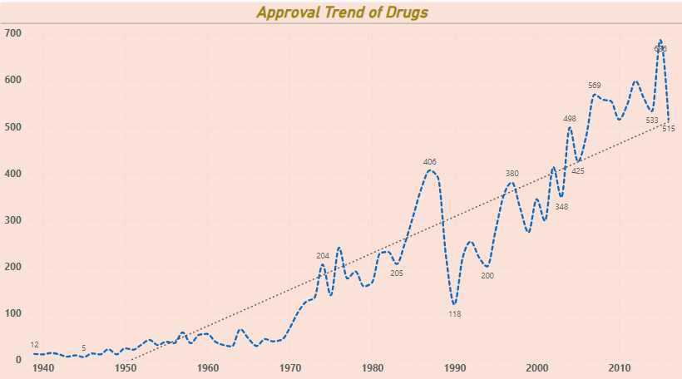
Yearly Approval Trends of Drugs
Approvals saw a remarkable 4,191.67% increase from 1939 to 2016, indicating a consistent rise in drug approvals over the years.
Starting in 2006, there was a notable 7.52% rise in Approvals over a decade, reflecting recent growth and advancements in the pharmaceutical field.
Between 1996 and 2005, Approvals jumped from 353 to 425, highlighting a significant spike in drug approvals during that period.
The steep inclines in Approvals suggest pivotal moments in drug approval processes, likely driven by regulatory changes or advancements in pharmaceutical research.

Slide 6
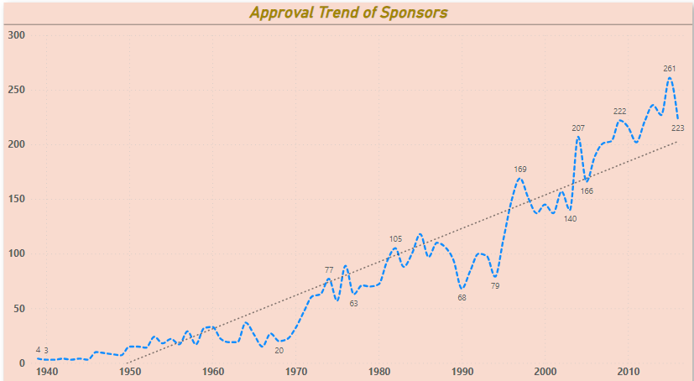
Approval Trends by Sponsors
Witnessing an impressive 5,475.00% surge from 1939 to 2016, the number of sponsor applicants reflects a remarkable increase in entities vying for drug approvals.
Beginning in 1993, there was a notable 127.55% uptick in sponsor applicants over 23 years, signaling recent momentum and heightened interest in sponsoring drug applications.
Between 1993 and 2016, sponsor numbers soared from 98 to 223, indicating a significant spike in sponsorship activity within the pharmaceutical sector.
The pronounced upswings in sponsor applicants delineate crucial junctures in sponsorship trends, likely influenced by regulatory shifts, market dynamics, or advancements in drug development.

Slide 7
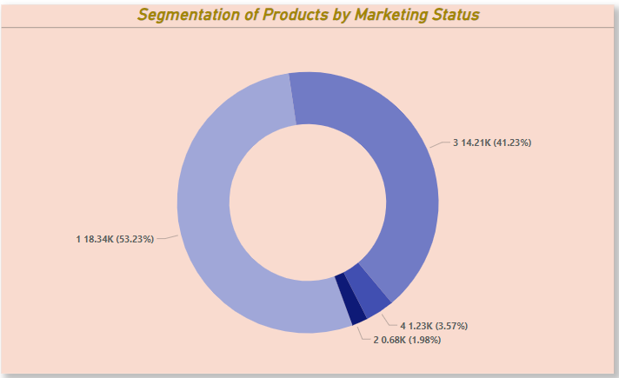

Segmentation of Products by Marketing Status
Product Segmentation: "1" leads with a count of 18,344 drug names, followed by "3", "4", and "2".
Market Dominance: "1" holds a significant share of 53.23% of the total count of drug names, indicating its strong presence in the market.

Slide 8
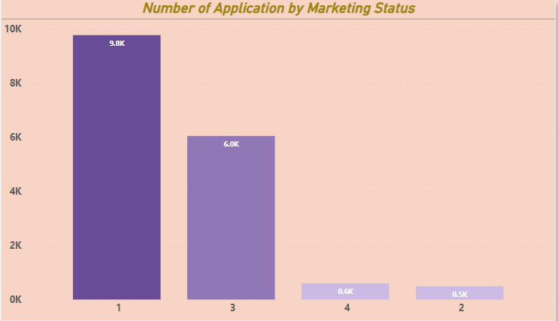
Total Applications by Marketing Status
The marketing status labeled as "1" commands the highest number of applications, reaching a total count of 9,777, significantly surpassing others by 1,891.24%, with "2" being the least at 491 applications.
Following the dominant "1" status, "3", "4", and "2" consecutively follow in the count of applications by marketing status.
This analysis sheds light on the distribution and disparity in application counts across various marketing statuses, offering valuable insights for strategic decision-making and resource allocation in product marketing and regulatory efforts

Slide 9
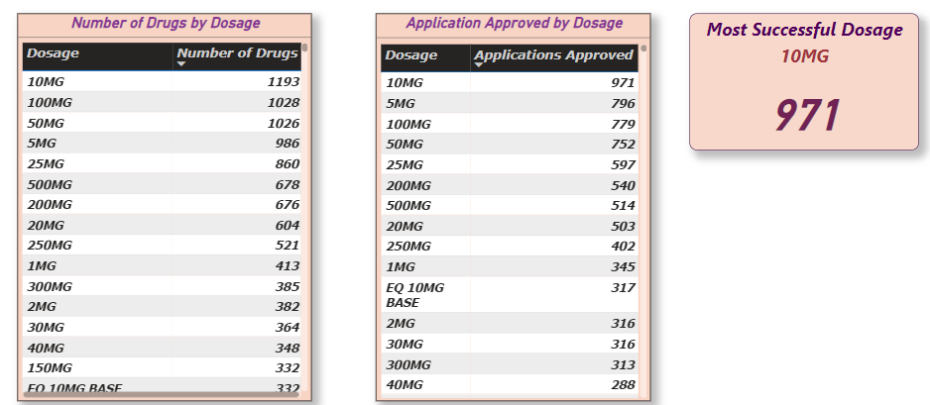
Analysis of Drug Dosage Forms
The 10MG dosage form stands out as the most prevalent, constituting a significant 1,193 drugs, representing approximately 3.46% of the total.
Among dosage forms, the 5MG variant takes the lead in application approvals, securing the top spot with 971 approvals, accounting for approximately 3.42% of total approvals.
Notably, the 100MG, 50MG, and 25MG dosage forms follow closely behind in both drug count and application approvals, underscoring their significance in the pharmaceutical market
These statistics offer valuable insights into the prevalence and approval trends of various drug dosage forms, guiding strategic decisions and resource allocation within the industry.

Slide 10
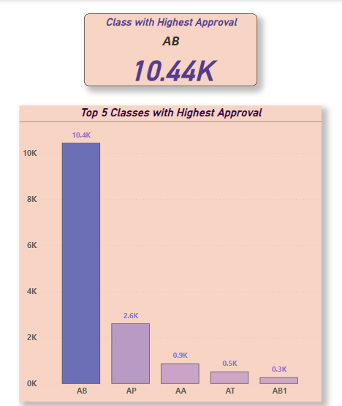
Drug Approvals by Therapeutic Classes
With a staggering count of 10,436 TE Code, "AB" emerges as the leading therapeutic class, demonstrating its significant presence in the market.
Accounting for an impressive 70.77% of the total of Top 5 TE Code count, "AB" commands a substantial share, underlining its strong influence in the therapeutic landscape.
The TE Code counts across all five therapeutic classes exhibit significant diversity, ranging from 281 to 10,436, indicating varying levels of engagement and demand within distinct therapeutic categories.
This examination provides valuable insights into TE Code distribution across therapeutic classes, aiding informed decision-making and resource allocation in pharmaceutical research and development.

Slide 11
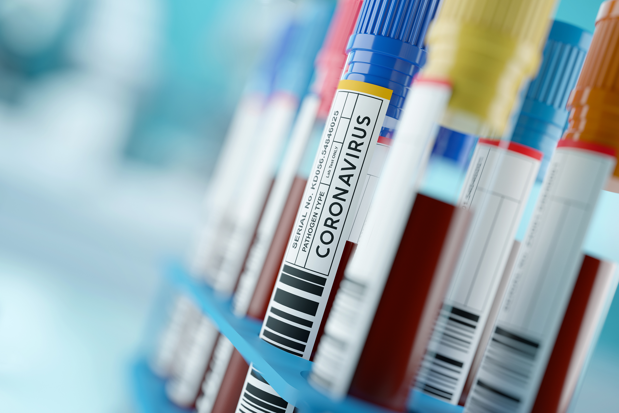

Insights from Drug Approval Analysis
Explored trends in drug approval over time, revealing significant increases and fluctuations in application counts, particularly during certain periods, with a 4,191.67% increase observed between 1939 and 2016.
Investigated patterns among different sponsors, showcasing substantial variations and trends in application counts across various sponsors, with a notable 5,475.00% increase observed between 1939 and 2016.
Analyzed segmentation of products by marketing status, highlighting dominant categories and their respective shares of total product counts, with "1" commanding the highest count at 9,777, accounting for 53.23% of total counts.
Examined drug approvals by dosage forms, identifying the most prevalent forms and their corresponding approval rates, with "10MG" dosage form having the highest count at 1,193, and "5MG" dosage form leading in application approvals with 971.
Explored drug approvals by therapeutic classes, revealing significant disparities in approval counts among different classes, with "AB" therapeutic class having the highest count at 10,436, accounting for 70.77% of total counts.

Slide 12


THANK
YOU
Your participation in our exploration of drug approval trends is greatly appreciated. For any inquiries or to delve deeper into the insights shared, please feel free to contact us. We value your engagement and look forward to further collaboration in leveraging data for informed decision-making.
+123-456-7890
www.ivision.com

